Slide 1
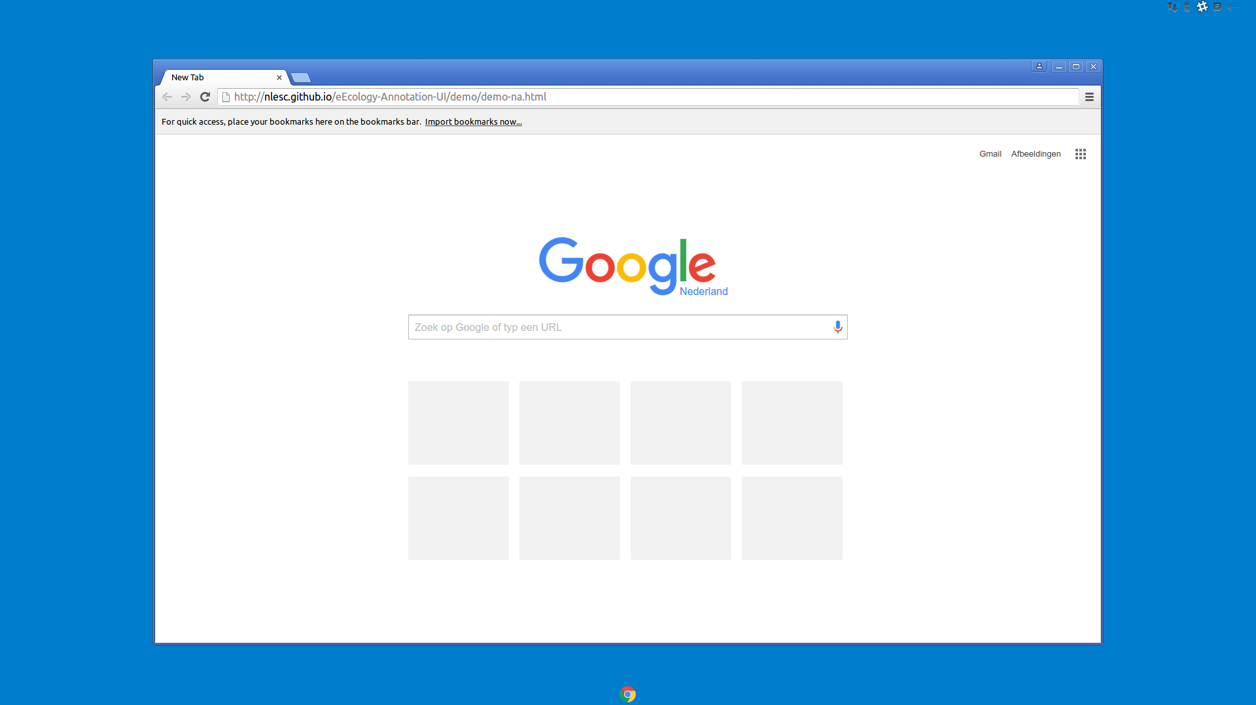
Start Google Chrome...

Slide 2
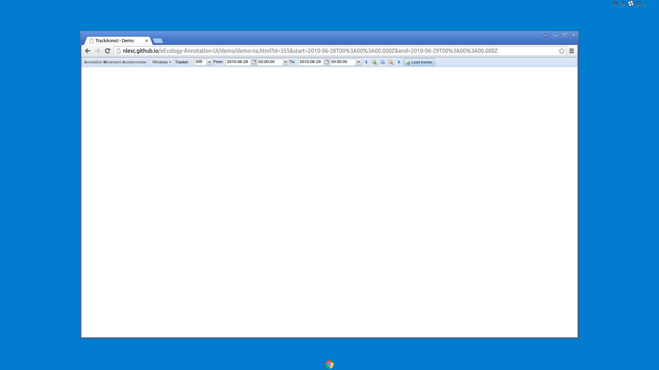
Select bird tracker ID 355 here...

Slide 3
...select start date/time here...

Slide 4
...select end date/time here...

Slide 5
...then click here.

Slide 6
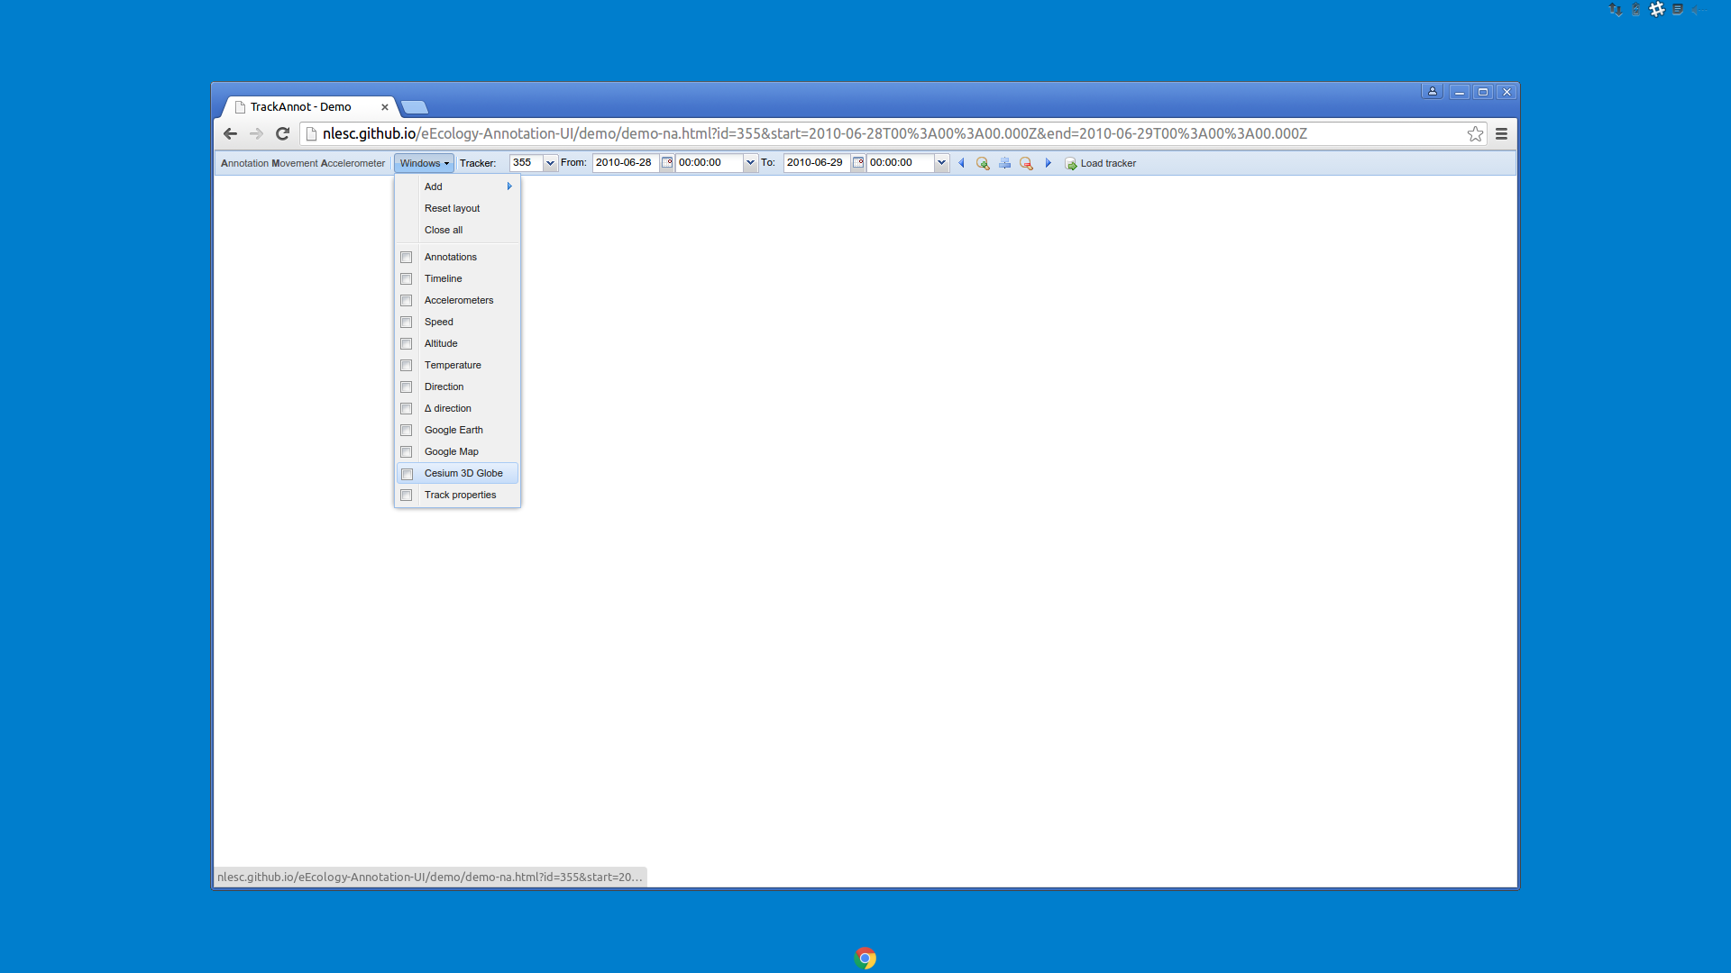
show the bird track on a map by clicking this

Slide 7
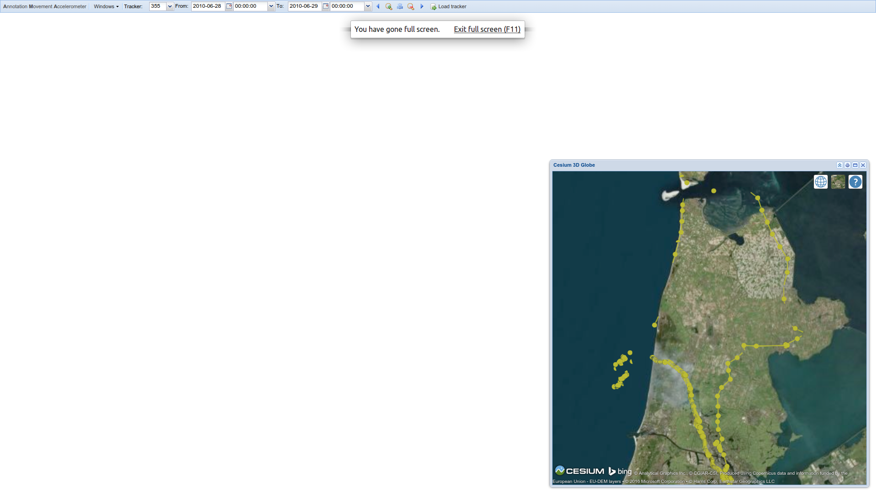
(press F11 to go Full screen)

Slide 8
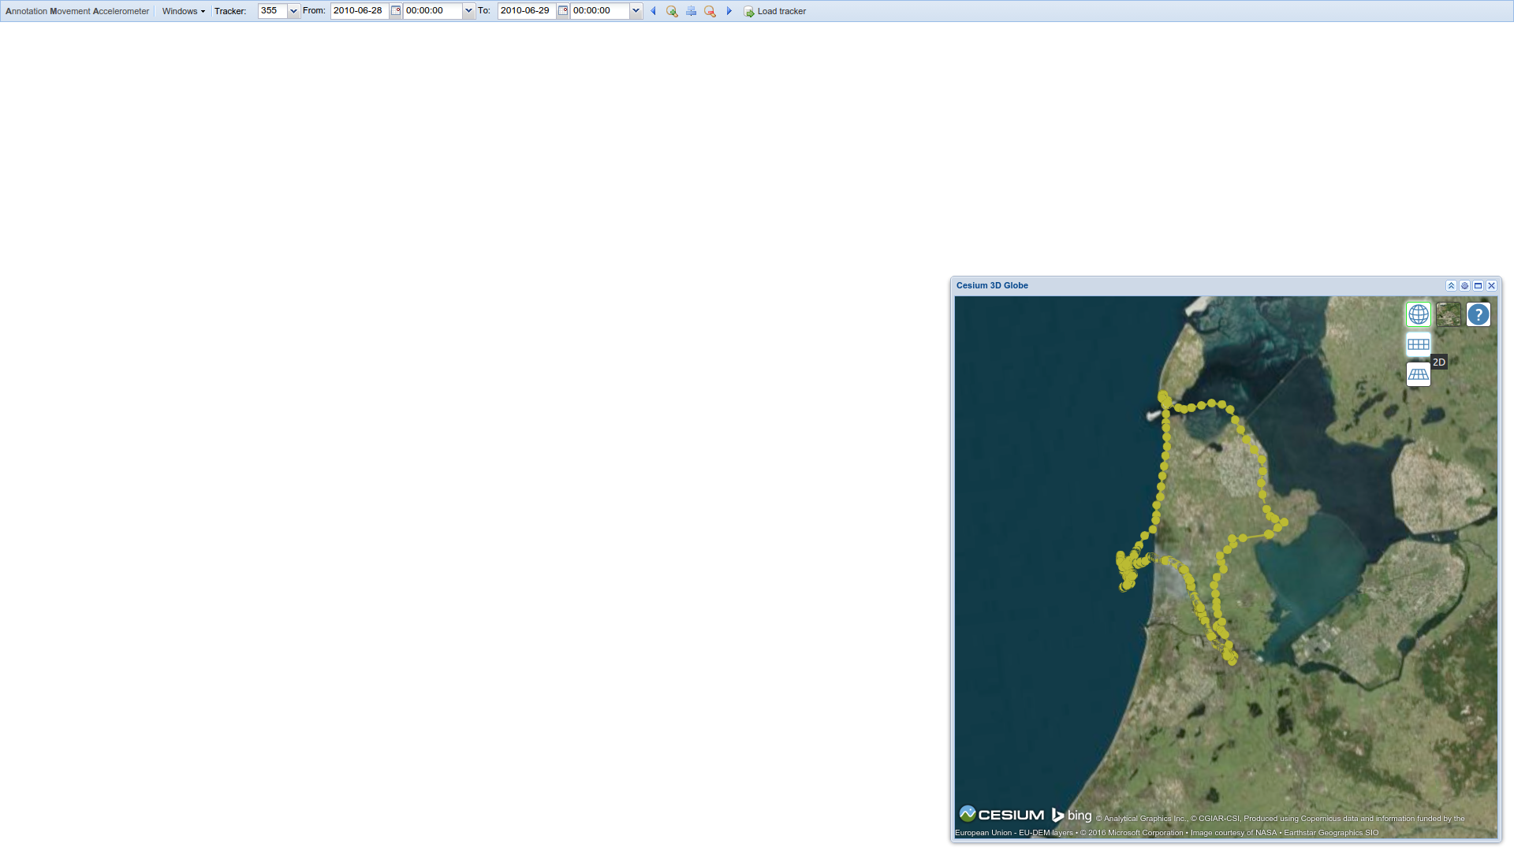
select 2D view

Slide 9
enable Timeline widget from this menu

Slide 10
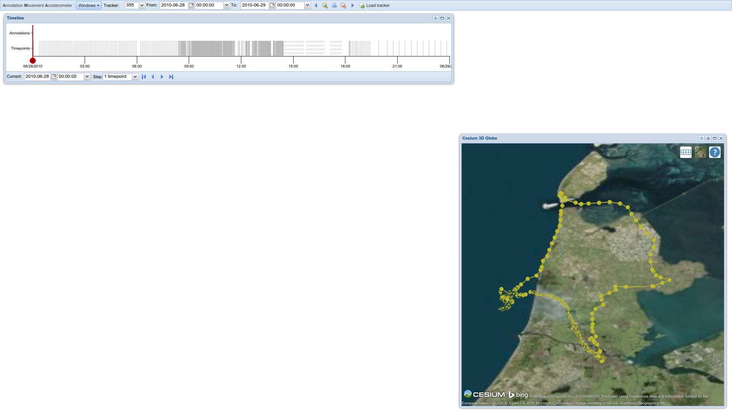
drag this slider back and forth...

Slide 11
drag this slider back and forth...
...and you’ll see the position update on the map

Slide 12
drag this slider back and forth...
...and you’ll see the position update on the map
let’s focus on the period 00:00 – 03:00...

Slide 13

...by setting the upper time boundary to 03:00

Slide 14
...on the 28th of June

Slide 15
...then click here to confirm loading the data.

Slide 16
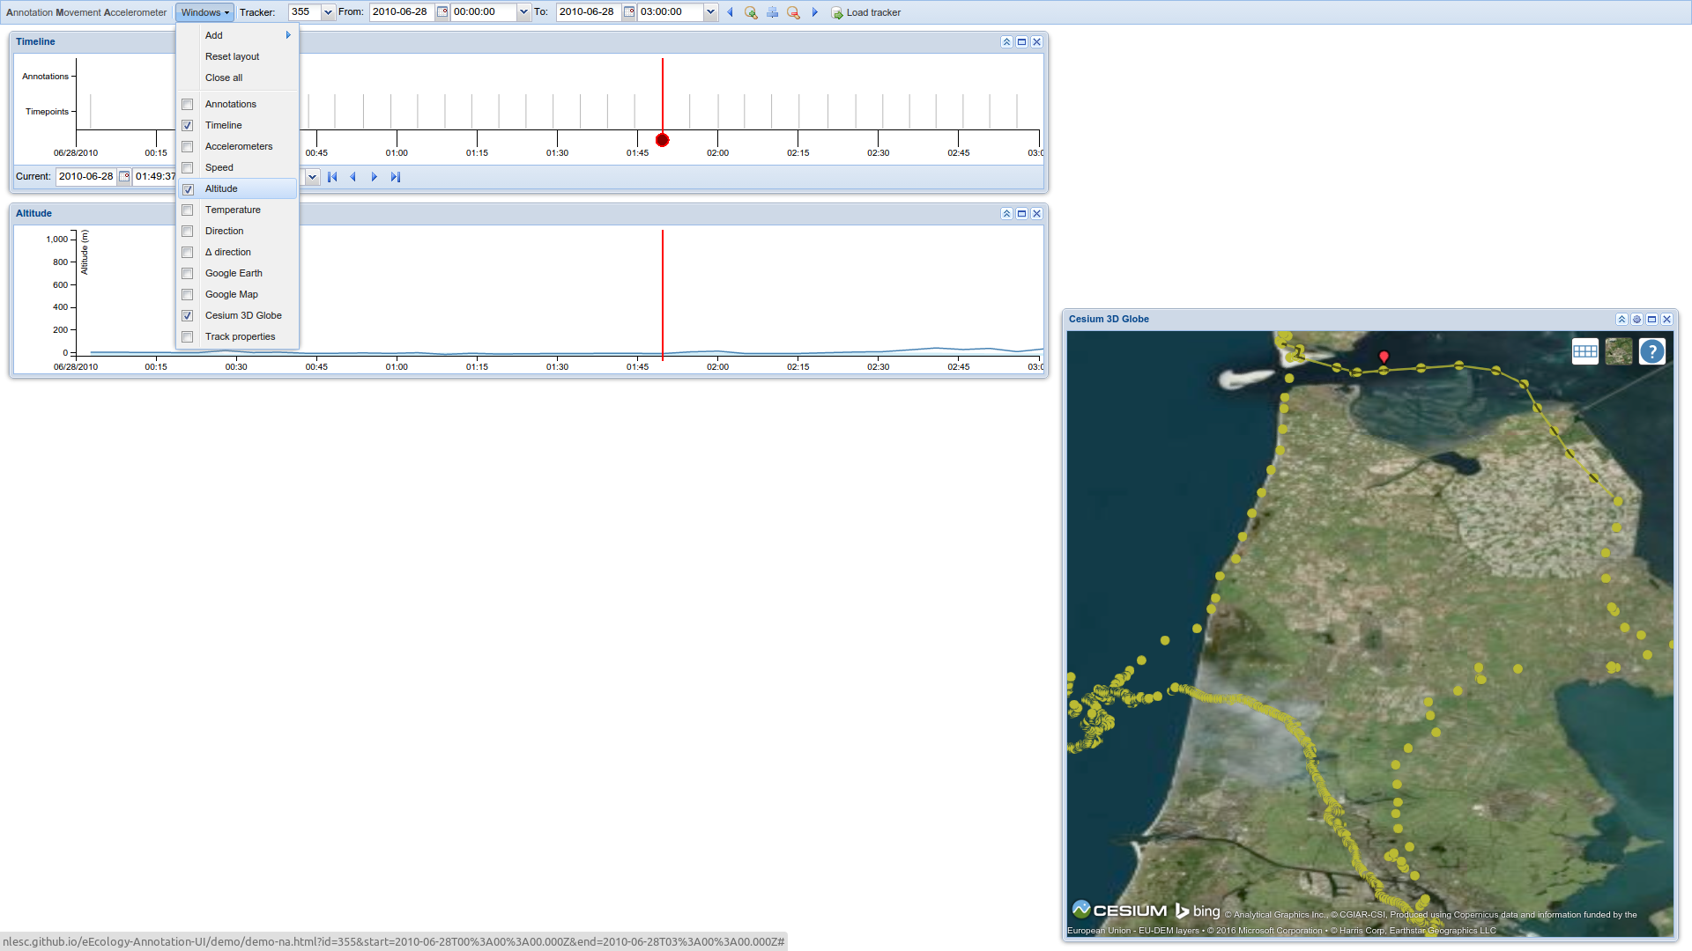
so it’s about 01:50 in the morning now...

Slide 17
...and the bird is currently here.

Slide 18
Let’s find out what it’s doing by showing some additional variables, such as Altitude...

Slide 19

...Temperature...

Slide 20
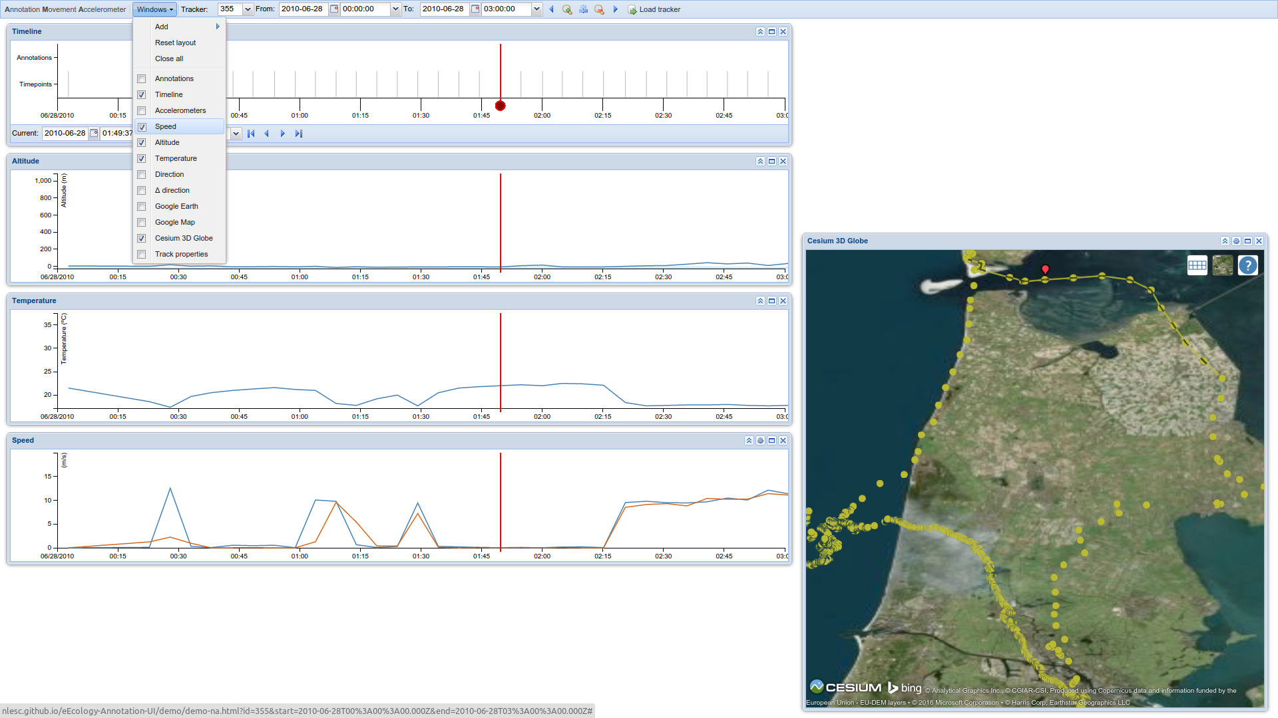
and Speed.

Slide 21
and Speed. FYI speed comes in 2 flavors: one is reported by the GPS sensor, the other is calculated from the change in position.

Slide 22
---
...these two periods seem to have more or less the same behavior...

Slide 23
---
similar altitude
similar temperature
similar speed
similar location
...these two periods seem to have more or less the same behavior...

Slide 24
...let’s see if the bird’s behavior is the same as well, by introducing some more data, from yet another sensor on the tracker, namely the accelerometer.

Slide 25
Accelerometer data is collected in bursts of up to 2 seconds. The gray lines in the Timeline widget each represent 1 burst.

Slide 26
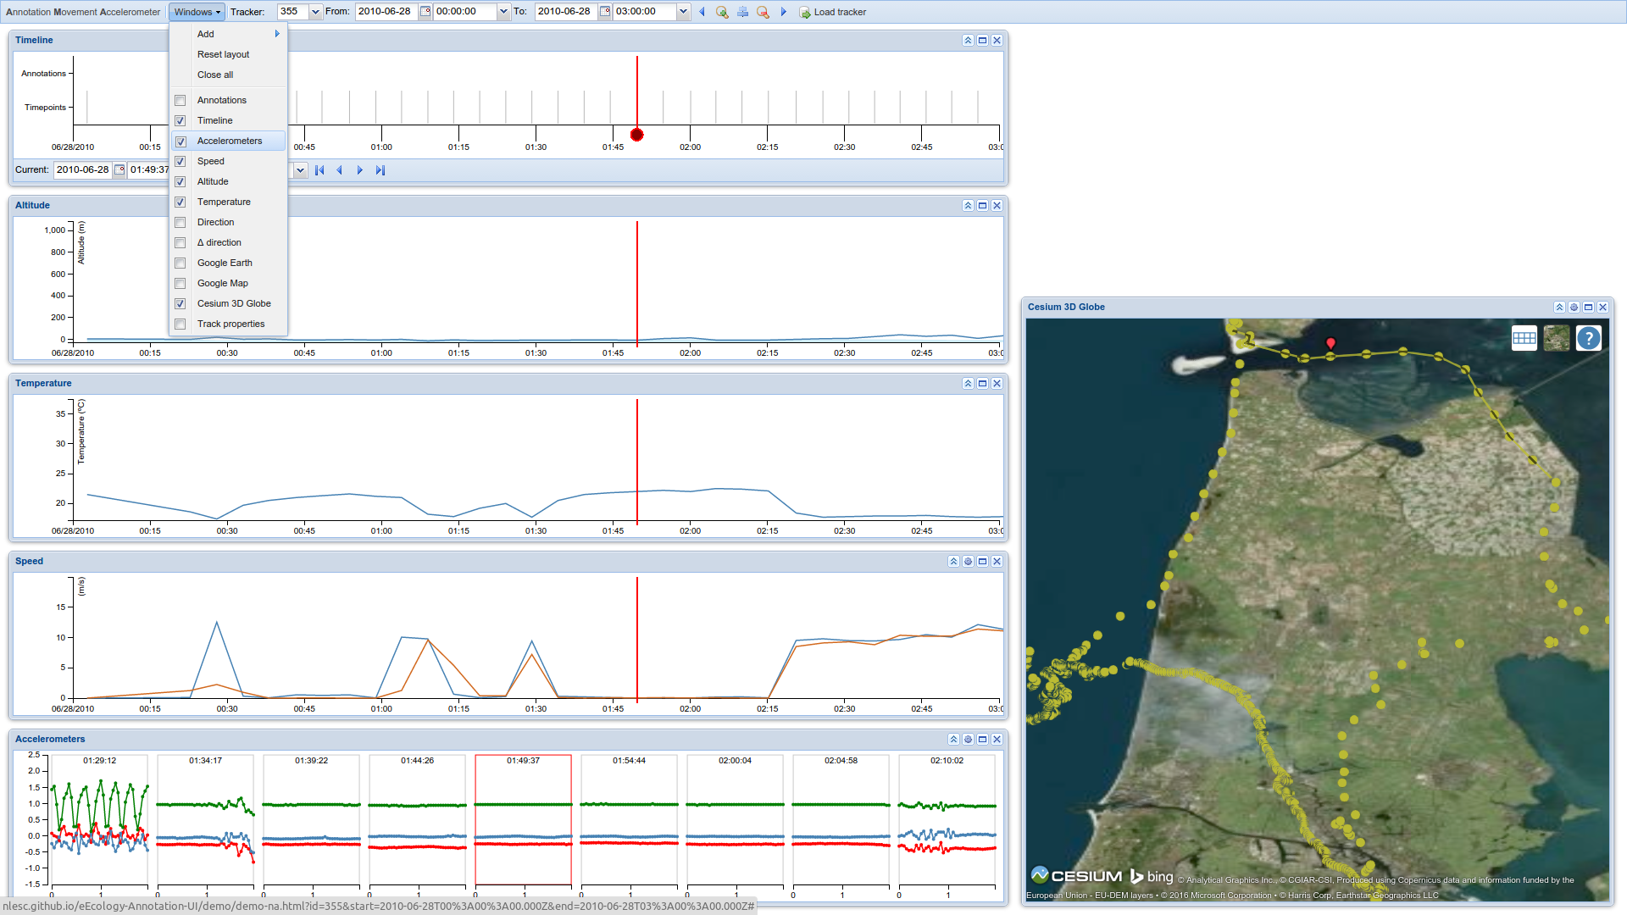
Click here to enable the Accelerometer widget

Slide 27
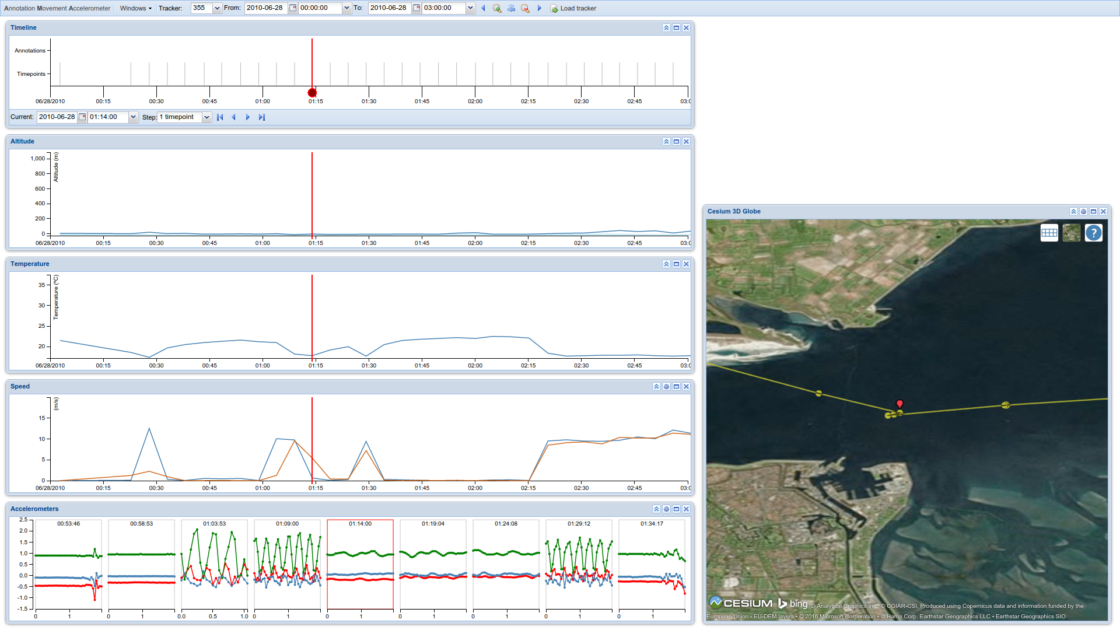
Set the time slider to 01:14...

Slide 28
This is the accelerometer data that was recorded at that time.

Slide 29
FYI the green line represents vertical movement; the smoothness of the signal suggests wave action.

Slide 30
We can now annotate this behavior as “floating on waves”

Slide 31
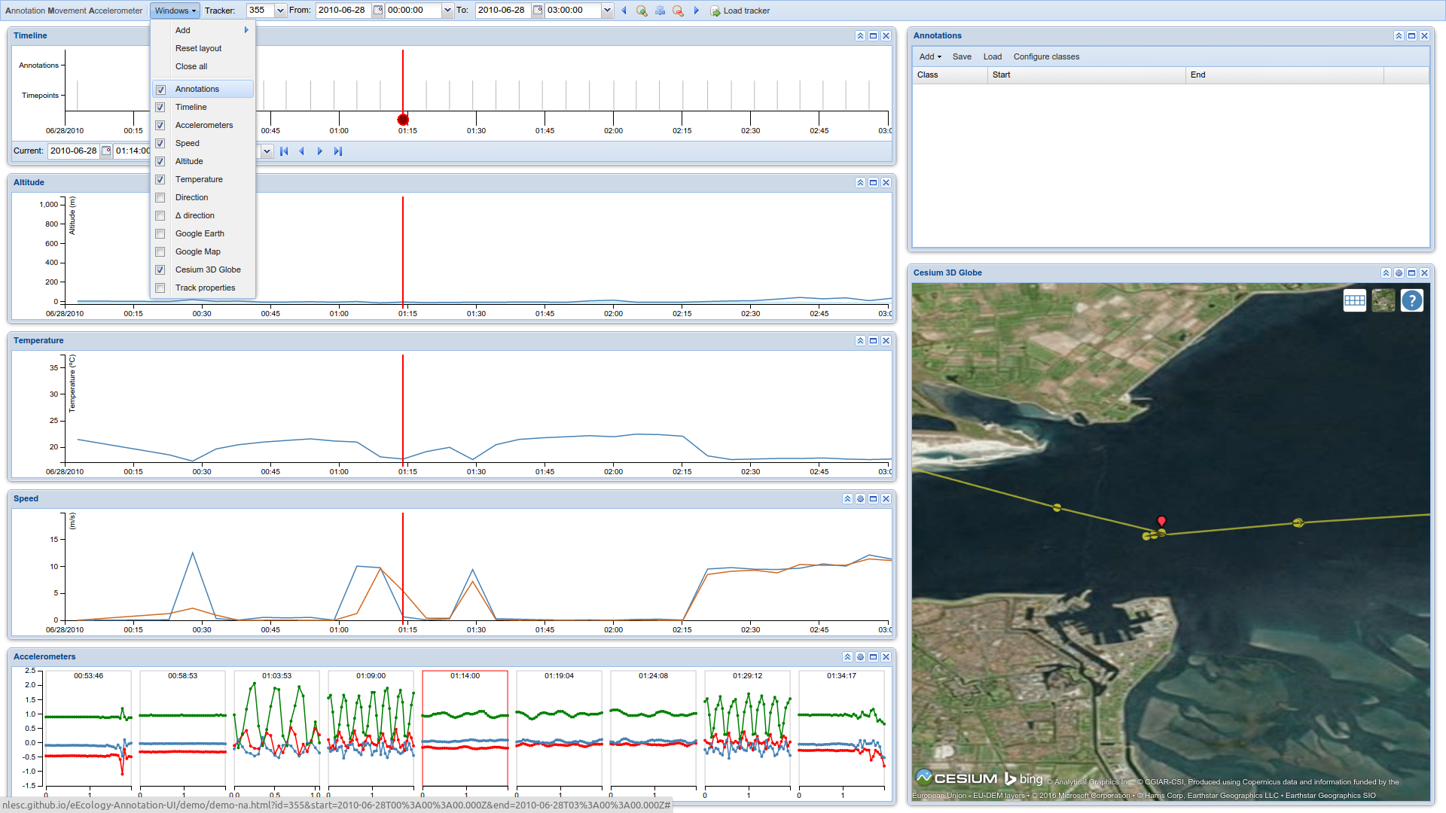
Enable Annotations widget...

Slide 32
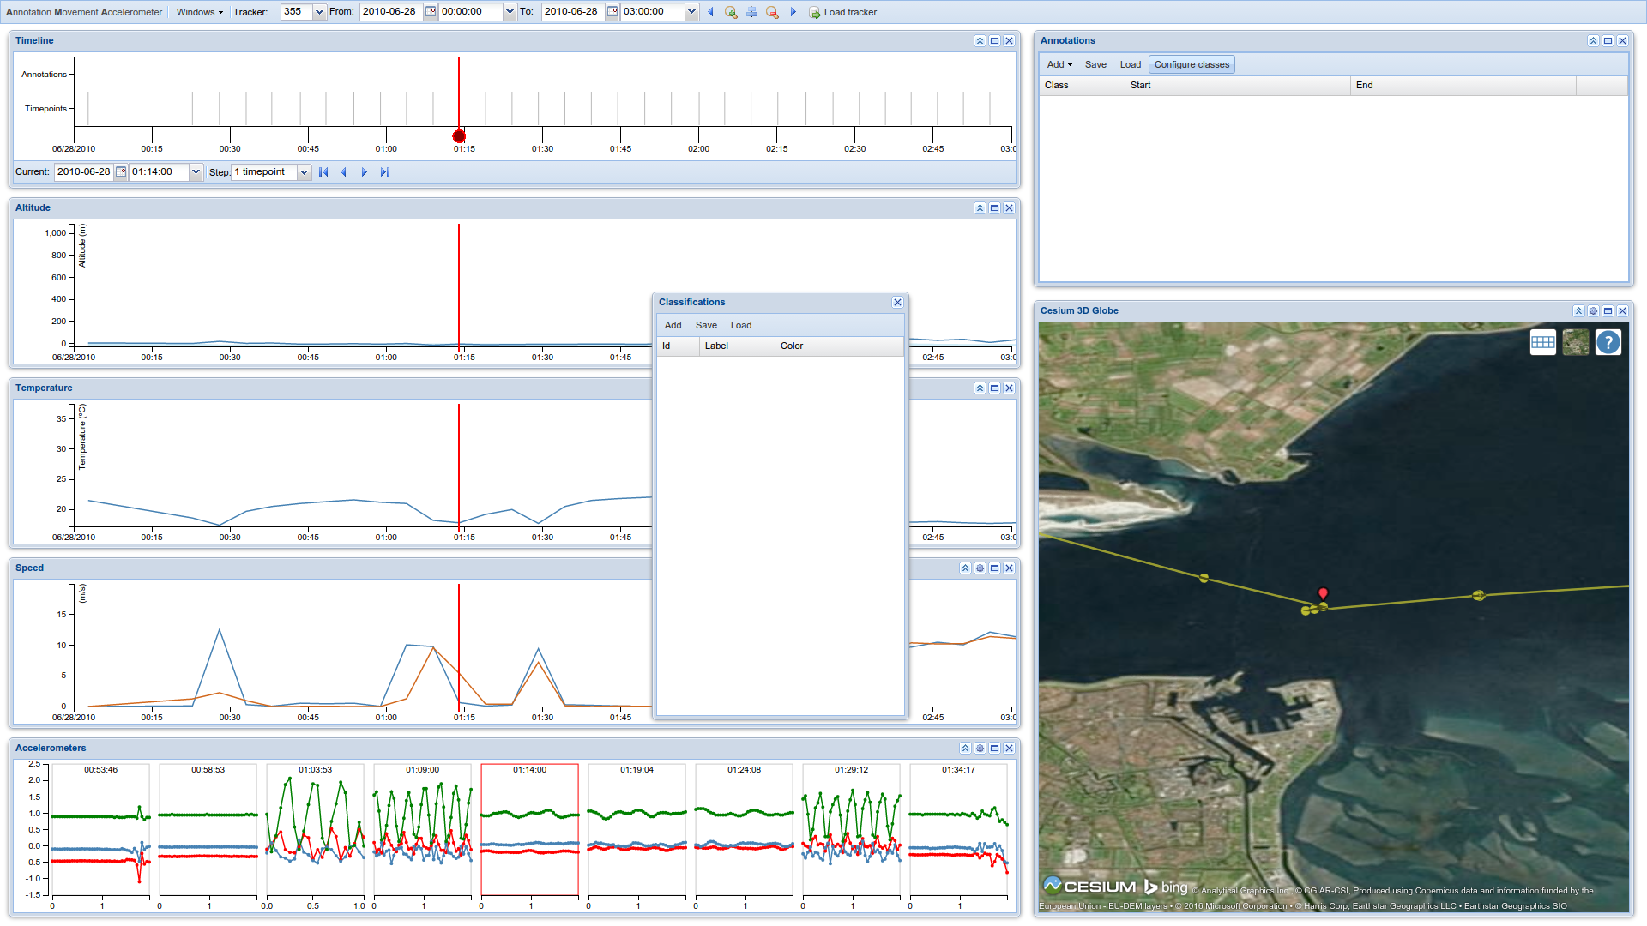
Click ‘Configure classes’

Slide 33
Click ‘Add’

Slide 34
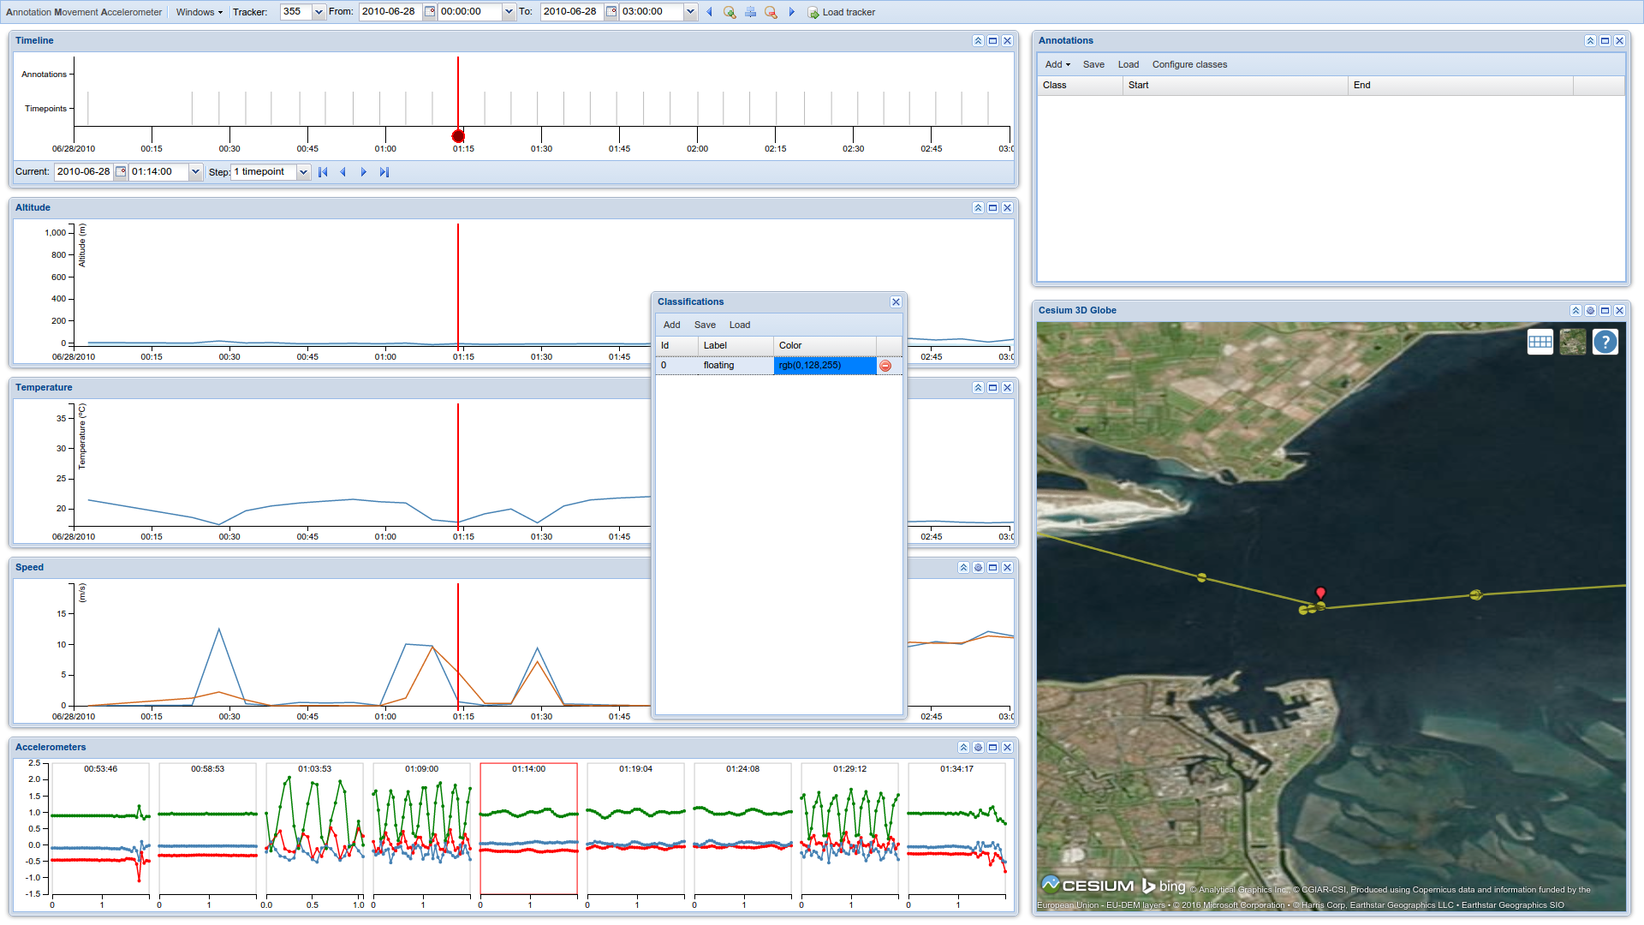
Set the color and label

Slide 35
Close the ClassificationsWidget

Slide 36
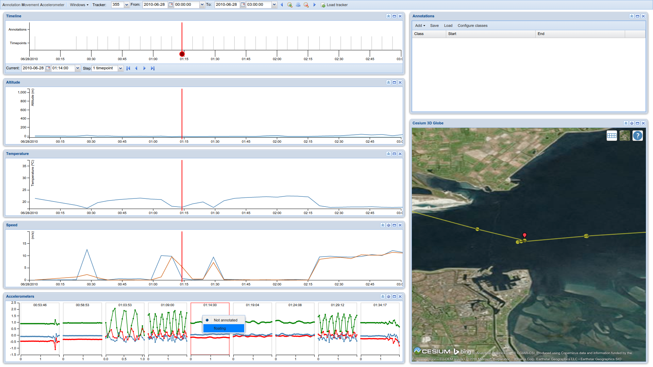
You can now annotate the data by left-clicking

Slide 37
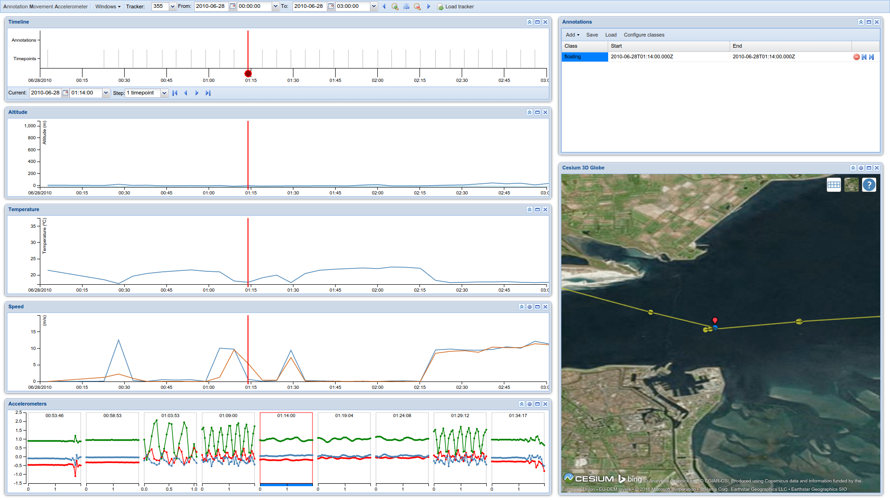
Note blue color here...

Slide 38
...here...

Slide 39
...underneath the time slider here...

Slide 40
...and in this list.

Slide 41
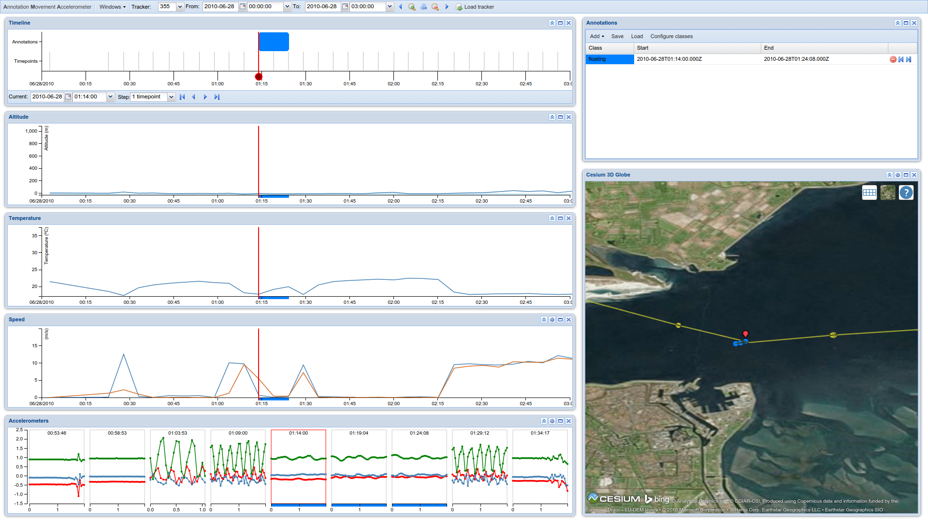
Repeat steps to annotate these bursts as well.

Slide 42
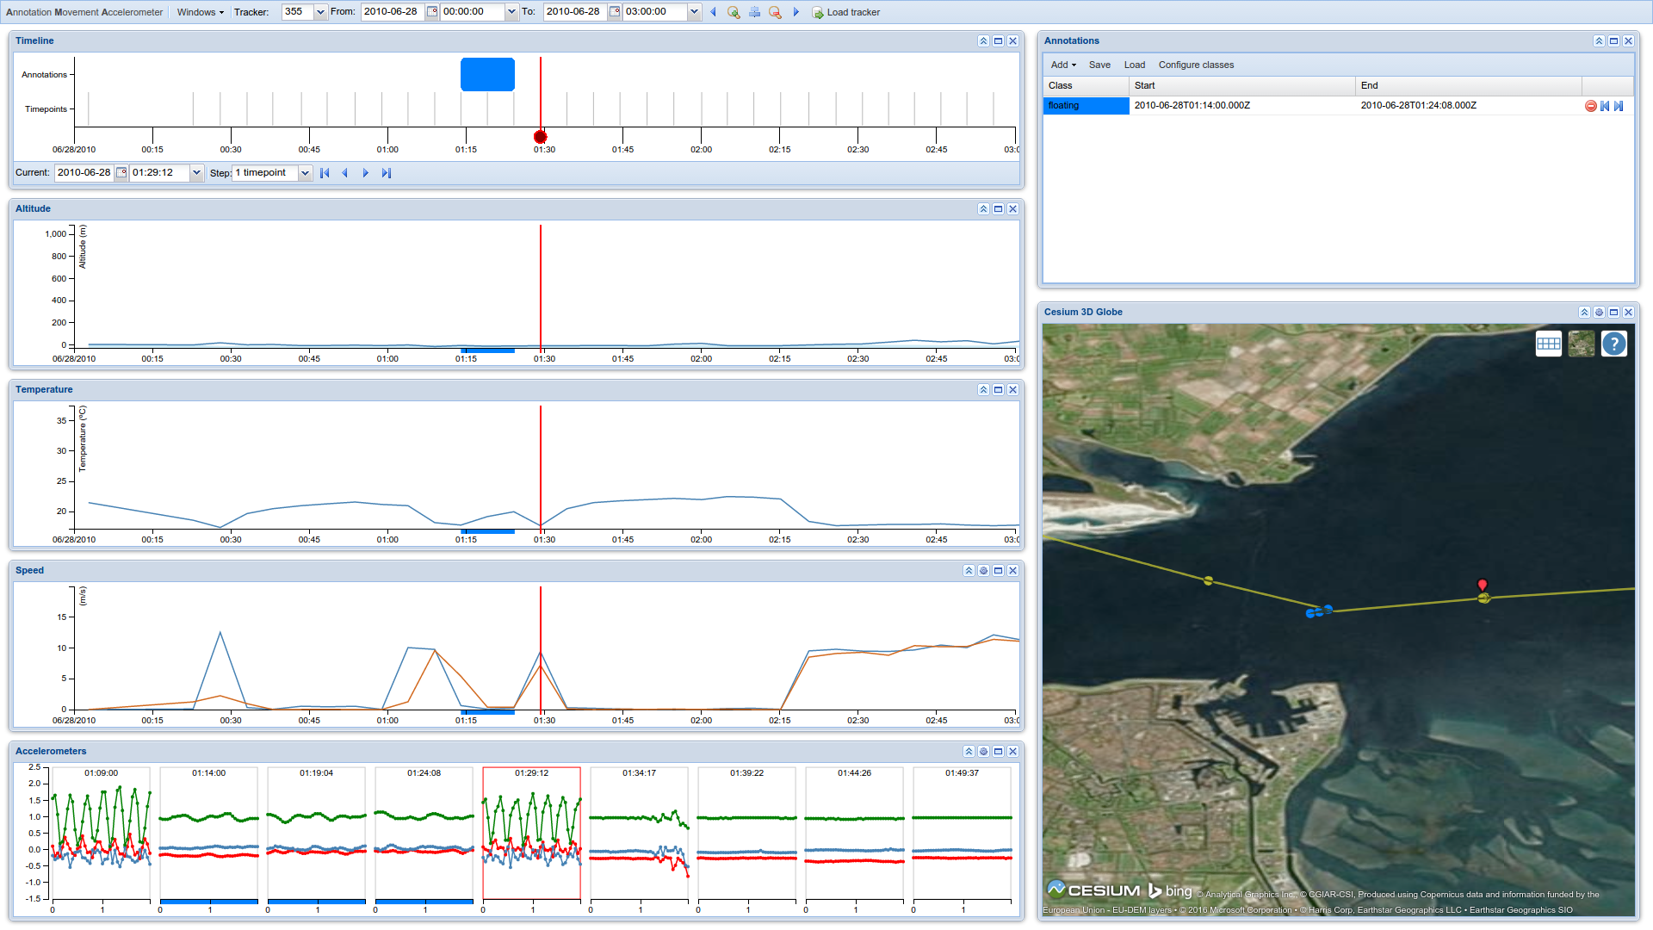
The next burst is really different, with respect to Speed, Temperature and Accelerometer, so we need a new class.

Slide 43
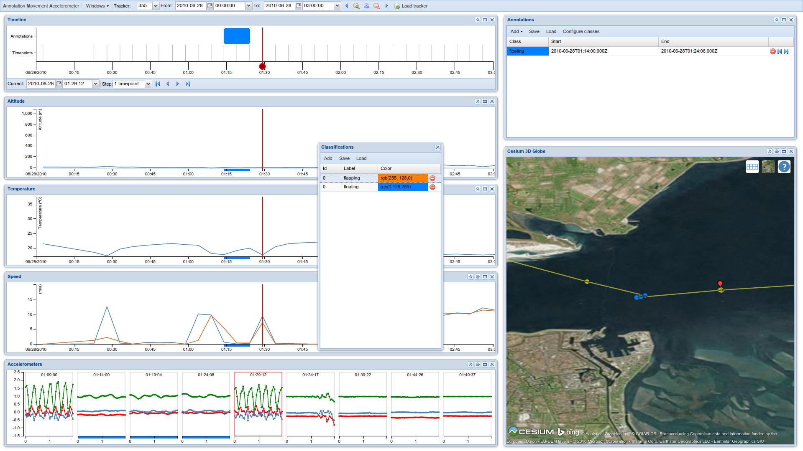
Define new class “flapping”

Slide 44
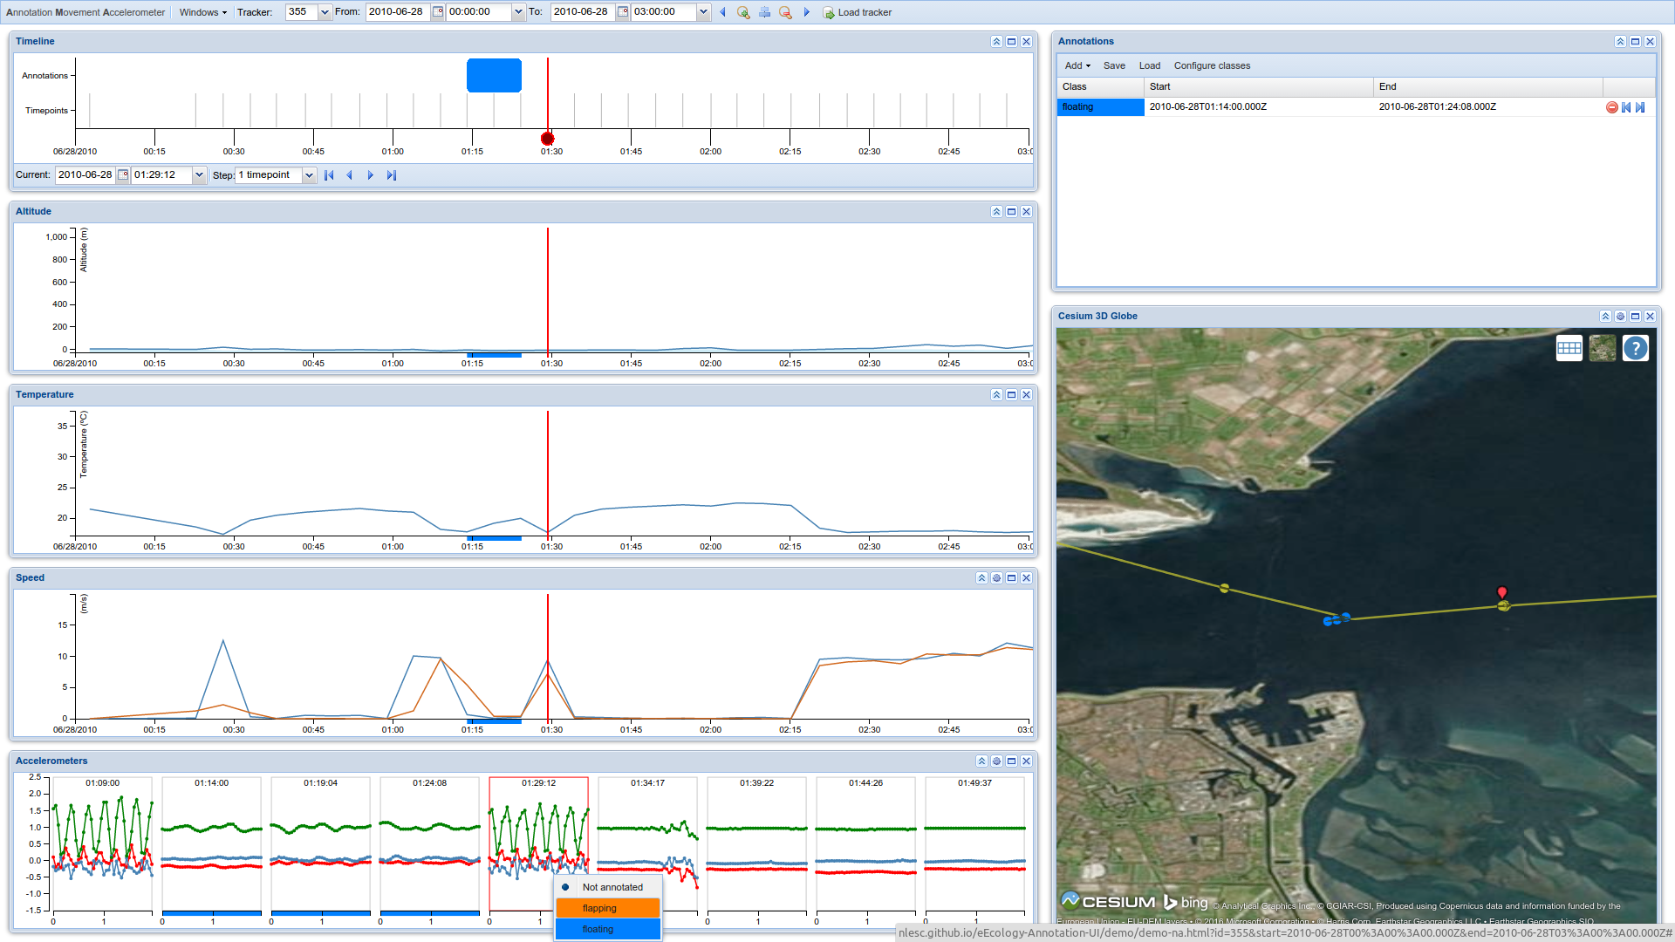
Annotate this behavior as an instance of “flapping”

Slide 45

Annotate this behavior as an instance of “flapping”

Slide 46
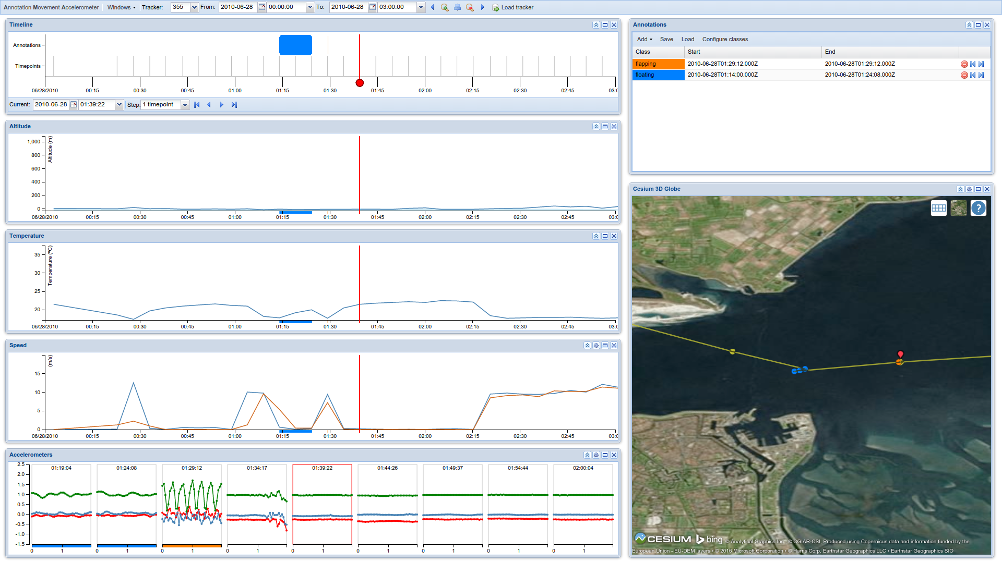
The next 40 minutes show Altitude, Temperature, and Speed values consistent with “floating”...

Slide 47
...but the accelerometer data suggests otherwise.

Slide 48
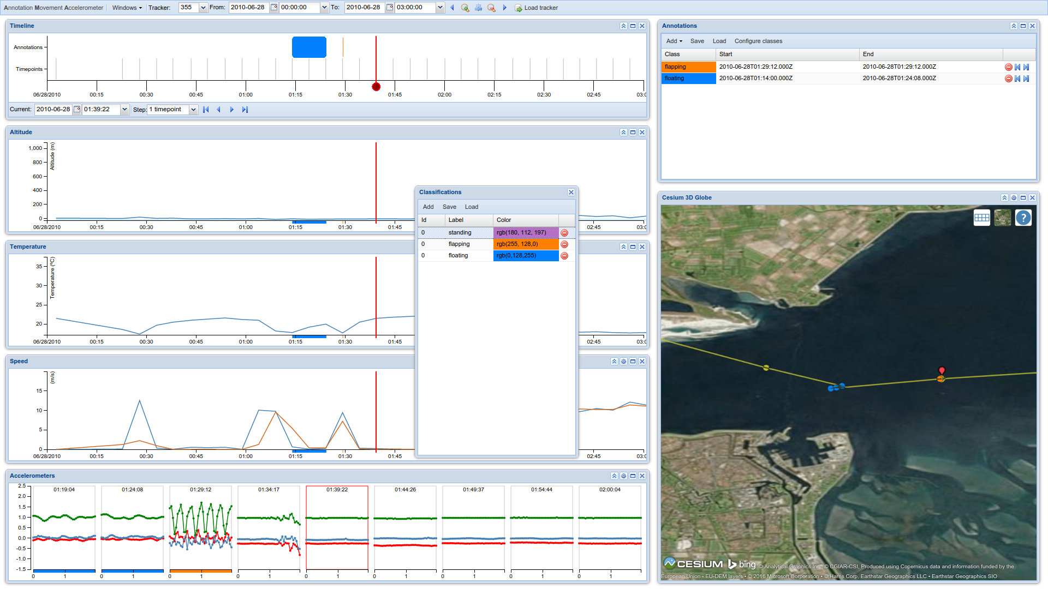
We need a new class, “standing”

Slide 49
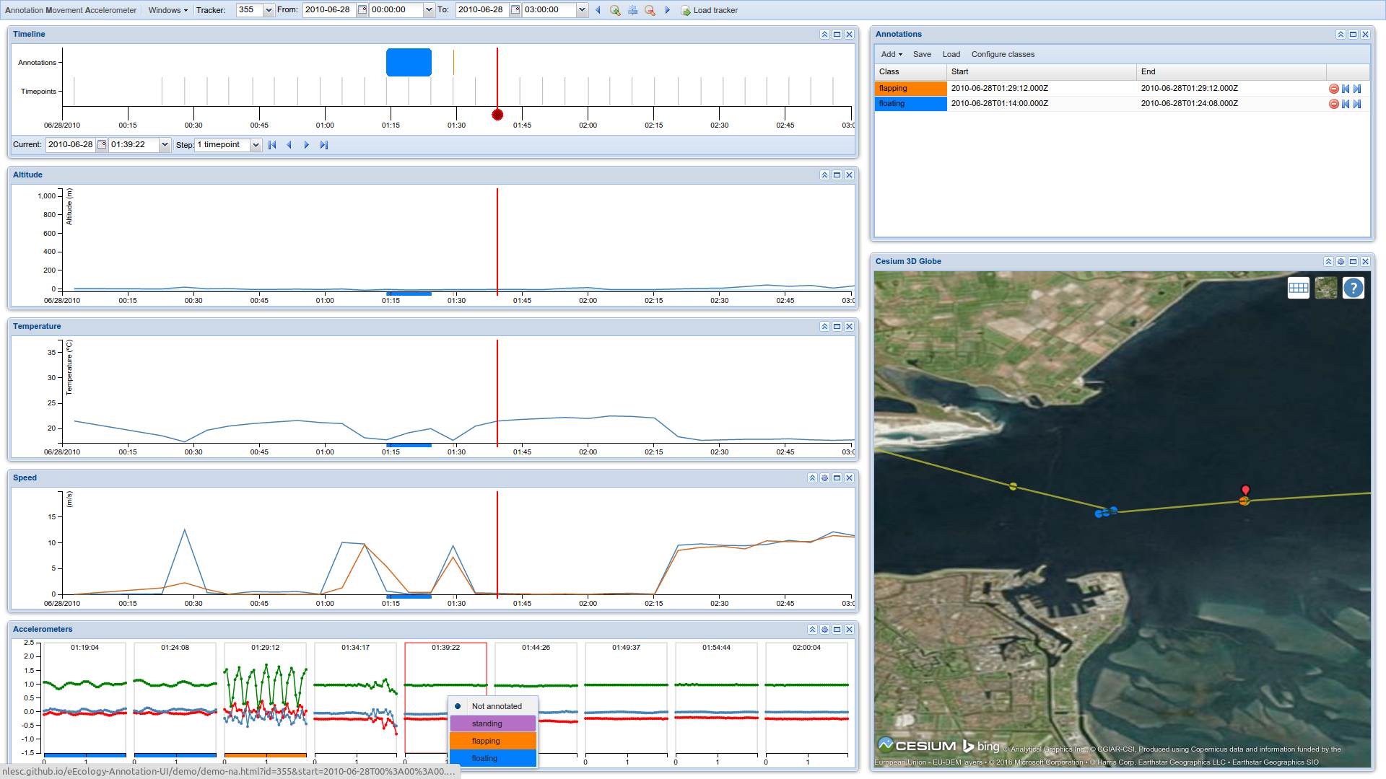
Now we can annotate this behavior as an instance of “standing”

Slide 50
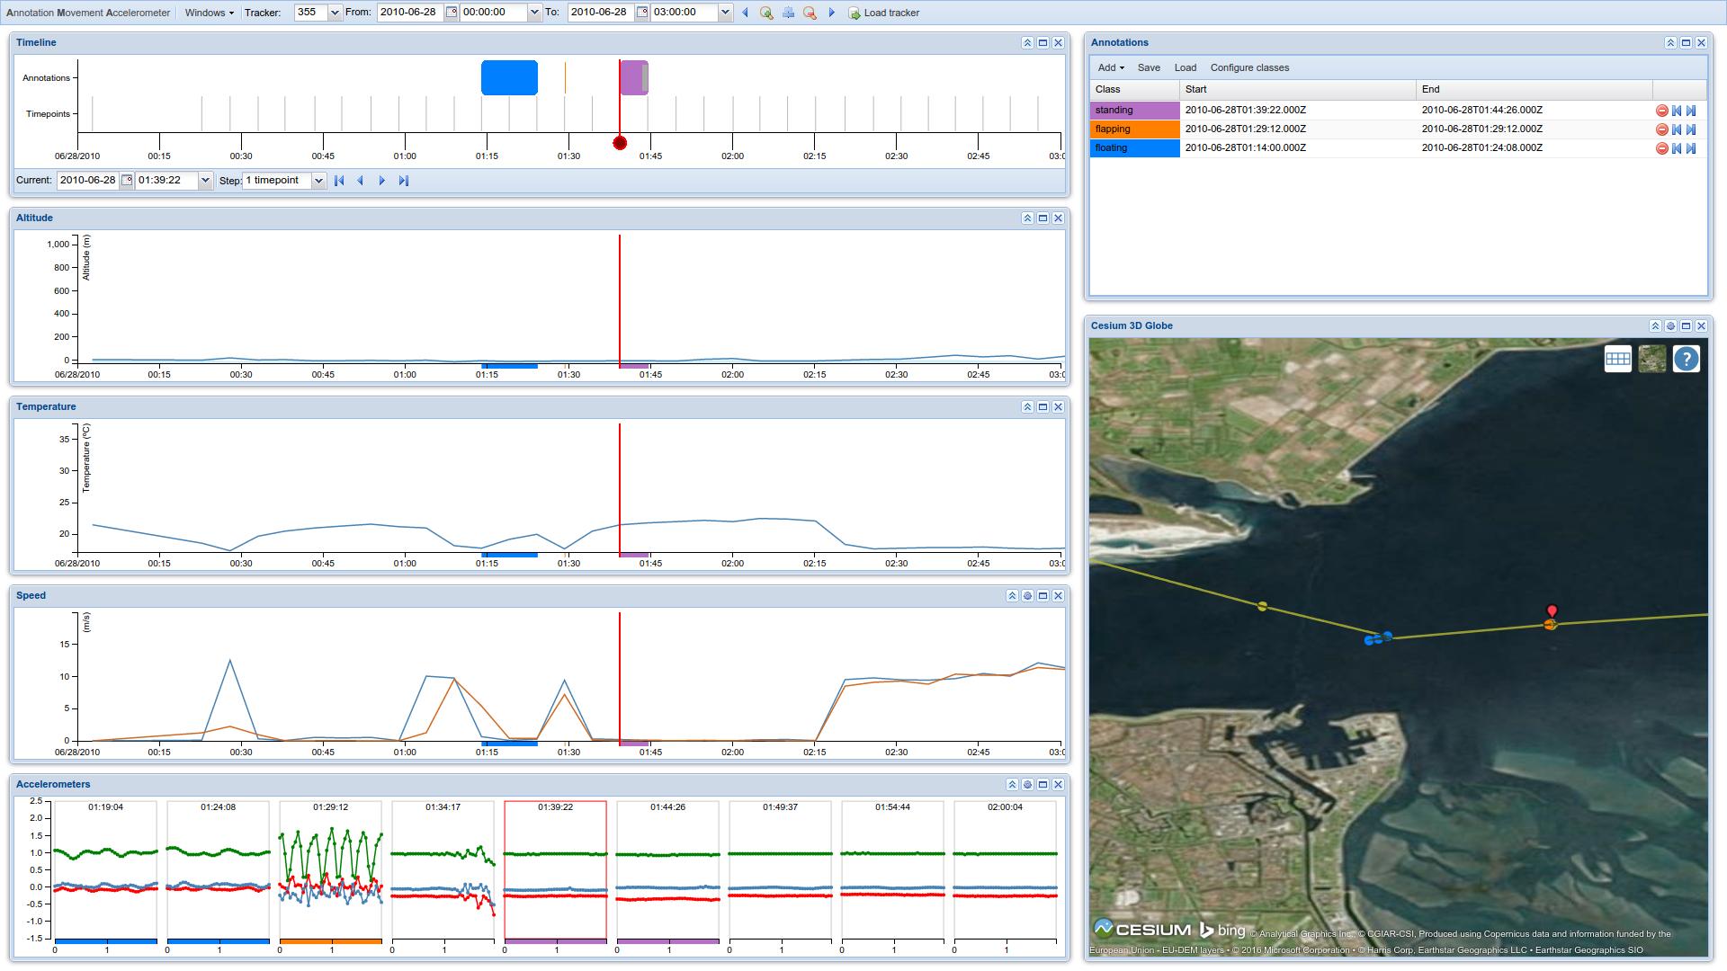
Drag to apply “standing” to the neighboring bursts as well

Slide 51
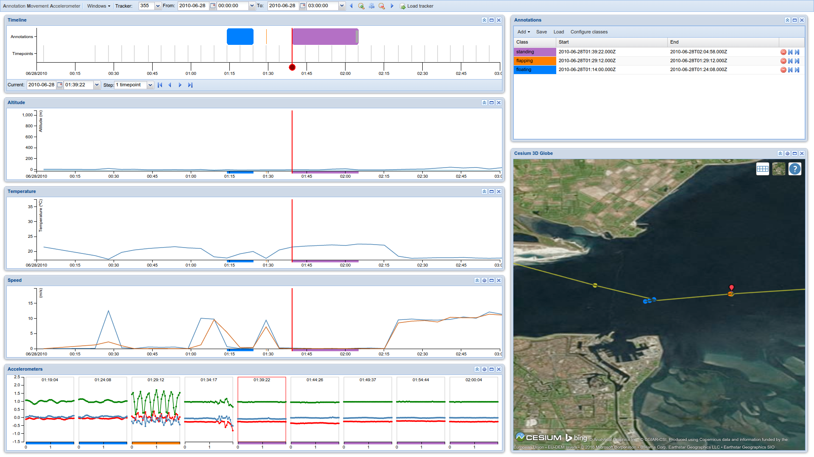
Drag to apply “standing” to the neighboring bursts as well

Slide 52
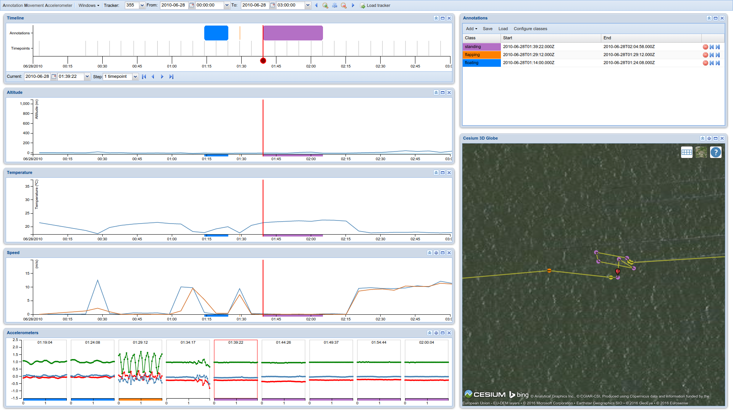
Note that when the bird was “standing” here, the tide must have been out.

Slide 53
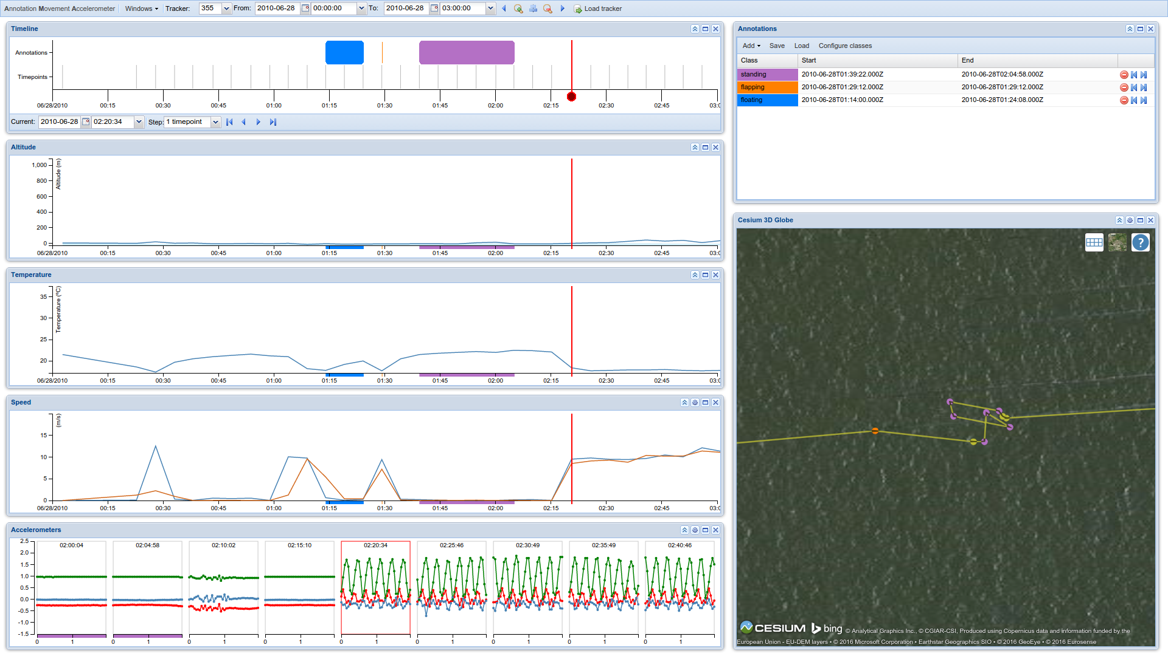
For the next 45 minutes or so, the bird is going at a speed of about 10 m/s, spending quite some energy in the process.

Slide 54
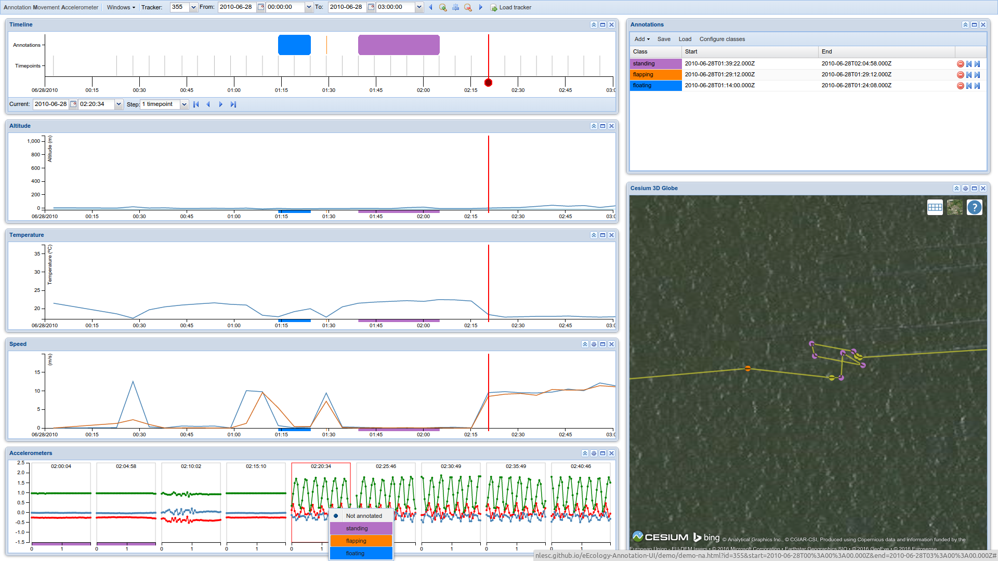
The behavior is the same as the “flapping” behavior, so we annotate it accordingly.

Slide 55
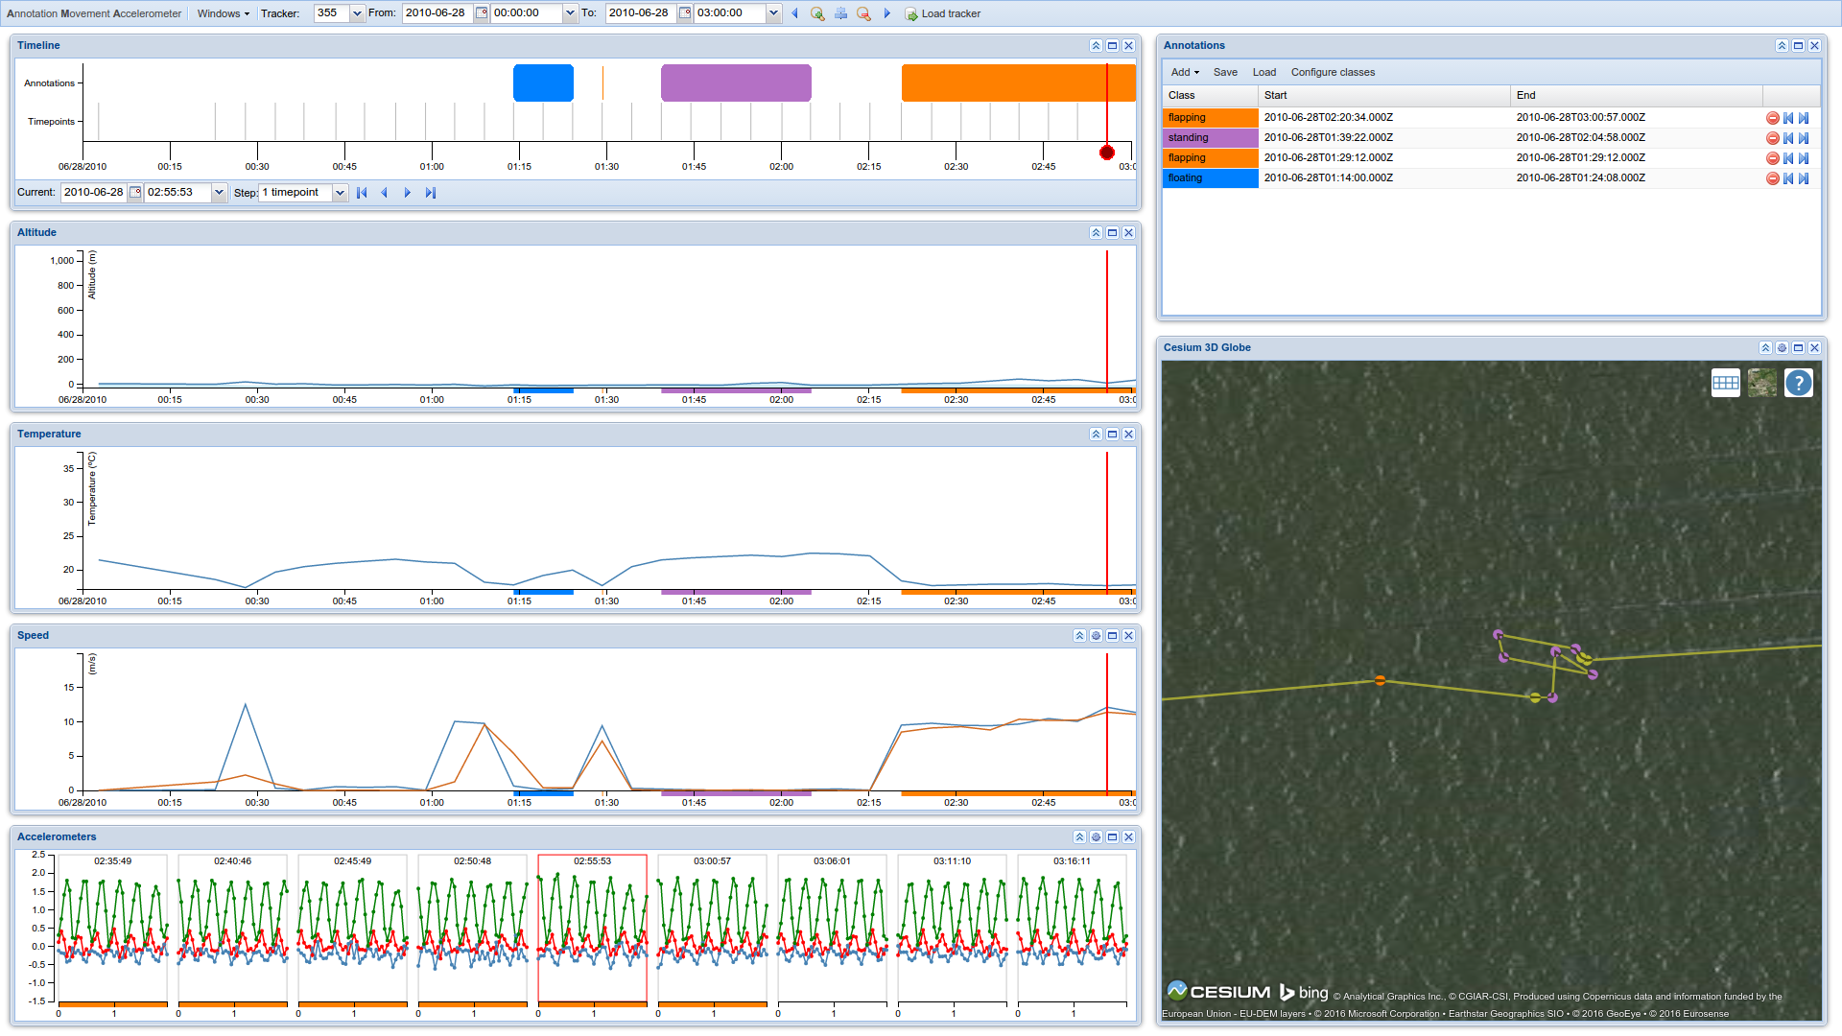

Slide 56
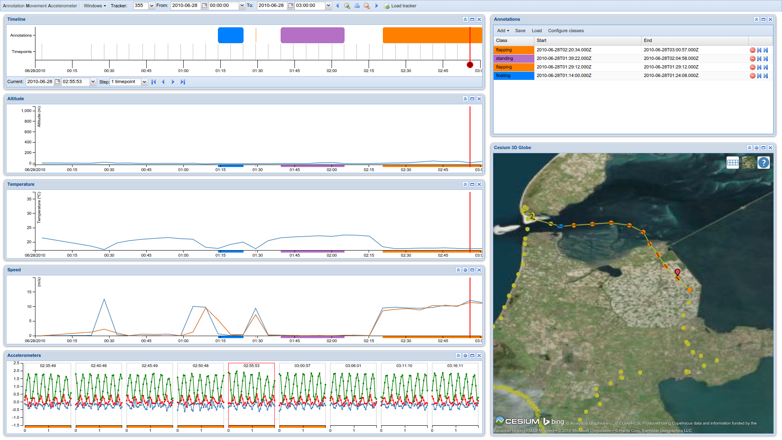
This is what it looks like when we zoom out. The bird has covered quite some ground while flapping.

